Slide 1
Storytelling Case Study: Airbnb, NYC
By : Sushma Mahagaonkar, Snehil Tiwari and Rahul Patra

Slide 2
Main Objective:
Airbnb is an online platform that facilitates the rental of unused accommodations.
During the COVID-19 pandemic, Airbnb experienced a significant decline in revenue.
As travel restrictions ease and people resume traveling, Airbnb is working towards revitalizing its business and preparing to cater to customer needs once again.

Slide 3
Background
Over the past few months, Airbnb has experienced a significant decrease in revenue.
With the relaxation of restrictions and an increase in travel activity, Airbnb is determined to be fully prepared for this shift.
To accomplish this, an analysis has been conducted on a dataset containing diverse Airbnb listings in New York.

Slide 4
Data Preparation
The dataset was thoroughly cleaned to eliminate any missing values and duplicates.
Insignificant columns were dropped from the dataset to focus on relevant information.
Outliers were identified and addressed to ensure data integrity and accuracy.

Slide 5
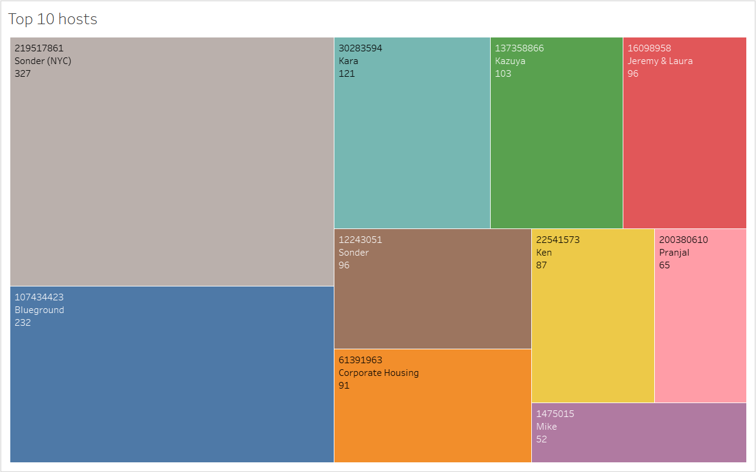
Top 10 Host
The host "Sonder(NYC)" (ID 219517861) has been booked the highest number of times, with a total of 327 bookings.
The second most popular host is "Blueground".
Other hosts such as Kara, Ken, Pranjal, Jeremy, and Mike also rank among the top 10 hosts based on booking frequency.

Slide 6
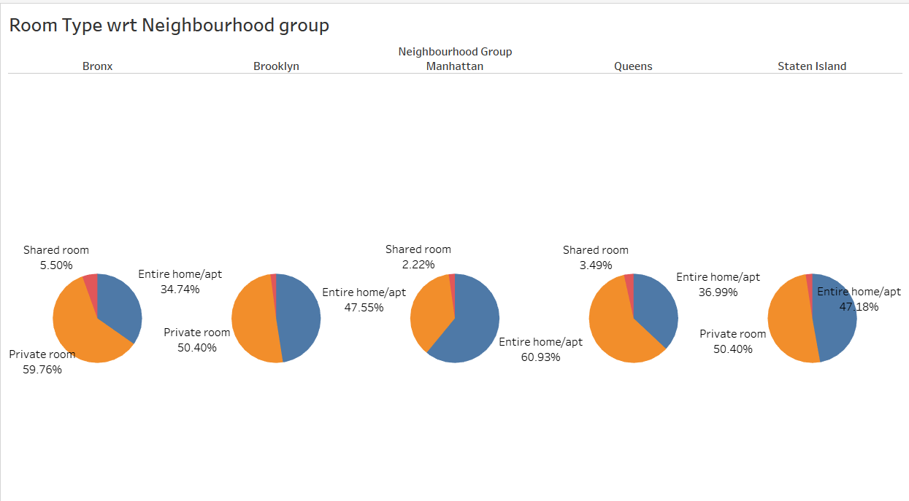
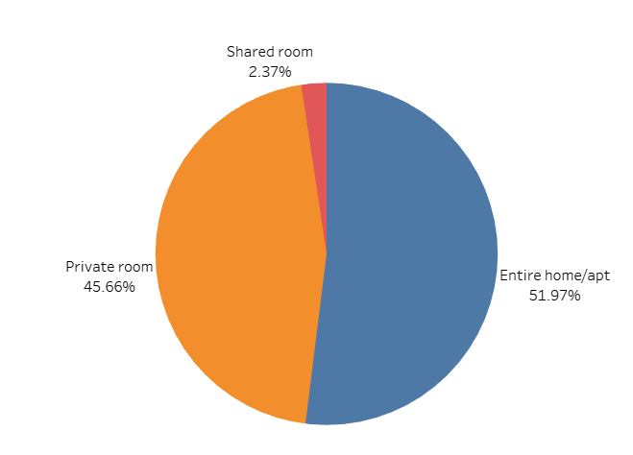
Room type with respect to Neighbourhood group
The data reveals three types of rooms available on Airbnb: Entire home/apartment, Private room, and Shared room.
Customers predominantly prefer Private rooms (45%) and Entire homes/apartments (52%) over Shared rooms (2.4%).
To boost bookings and expand their offerings, Airbnb can focus on promoting Shared rooms by offering discounts and incentives, as well as encouraging hosts to provide more Private listings.
In terms of specific neighbourhoods, Queens and Bronx both contribute 60% each to the Private room category, surpassing the combined ratio of 45%. On the other hand, Manhattan has a higher contribution of 61% in the Entire home category, compared to the combined ratio of 52%.

Slide 7
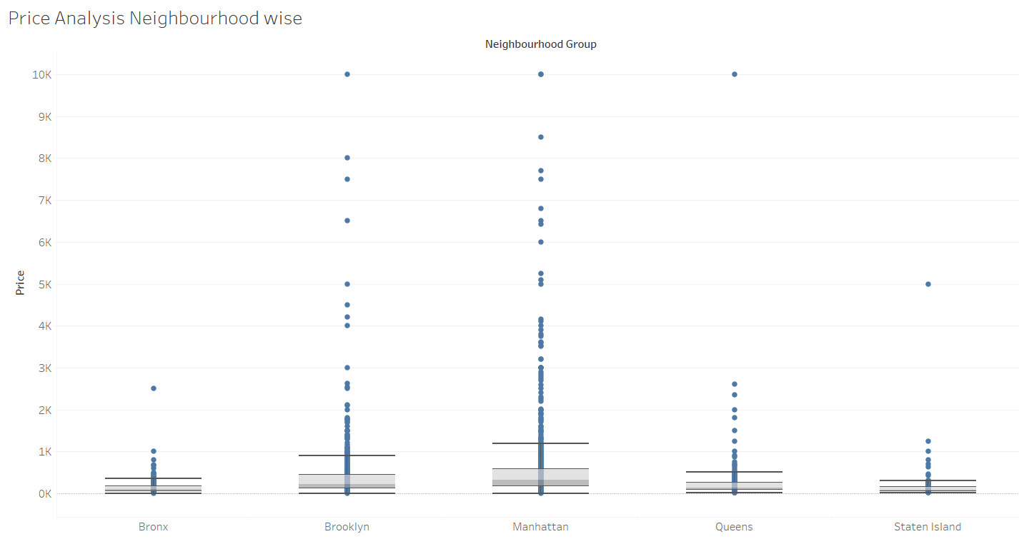
Price Analysis Neighbourhood wise
The majority of outliers in the Price column were found in Brooklyn and Manhattan.
Manhattan exhibited the highest price range among all the neighbourhood groups.
On the other hand, the Bronx had the lowest prices among the observed areas.
The median price for all neighbourhood groups fell within the range of $80 to $300.
Due to a highly positive skewness, the median was closely aligned with the lower quartile, with a few outliers apparent in the boxplot.

Slide 8
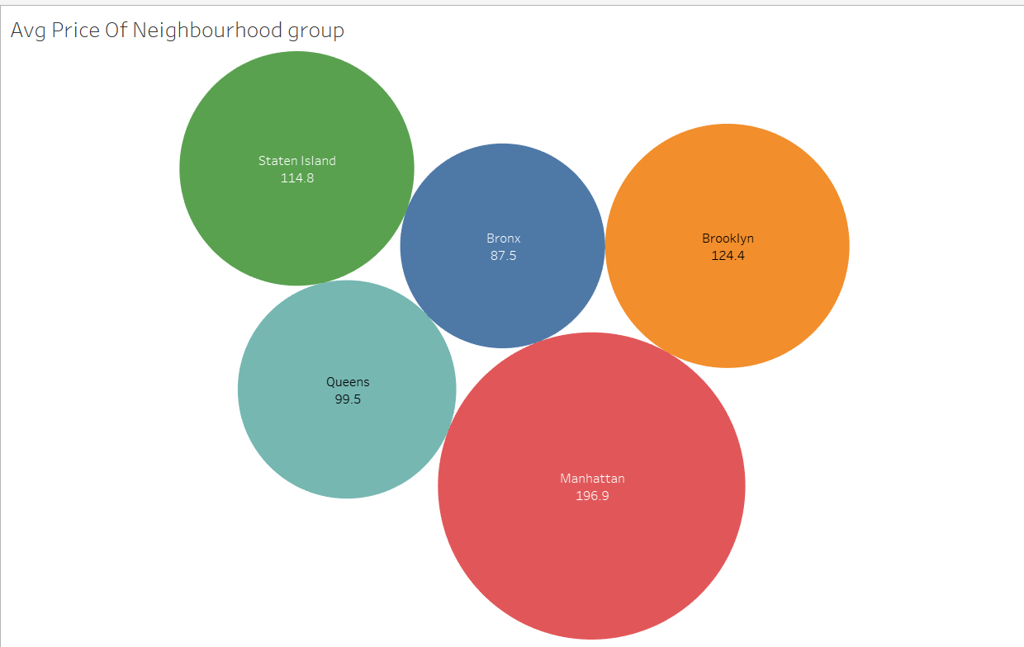
Average price of Neighbourhood groups
The average price of listed properties in Manhattan is approximately 196.9, making it the highest among all neighbourhoods.
Brooklyn follows closely with the second-highest average price of 124.4.
In contrast, Bronx is considered a more affordable neighbourhood, as its average price is nearly half of Manhattan's average price.

Slide 9
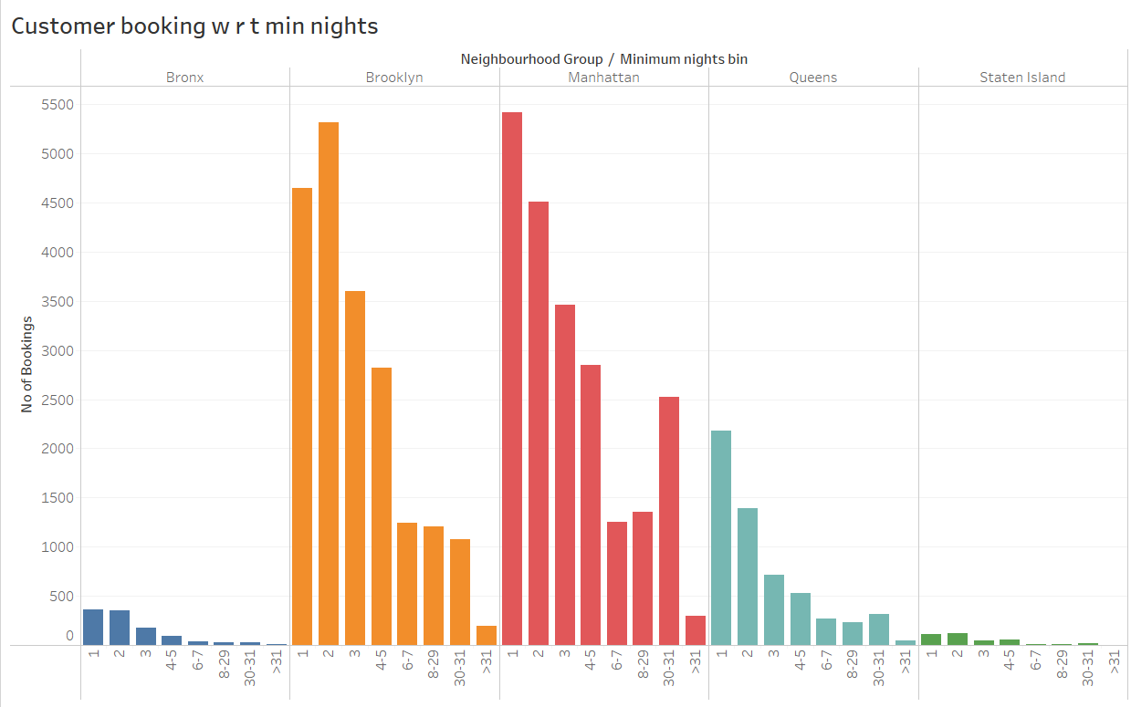
Customer Booking with respect to minimum nights
The analysis reveals that listings with a minimum stay of 1-5 nights have the highest number of bookings. Notably, there is a prominent spike in bookings for 30-day stays, which indicates a preference for monthly rentals among customers. Additionally, there are smaller spikes observed after 30 days, suggesting a continuation of the trend for longer-term rentals.
When examining the 30-day bookings by neighbourhood, Manhattan and Queens stand out with a higher number of such bookings compared to other areas. This could be attributed to tourists opting for extended stays or mid-level employees seeking budget-friendly accommodations during company visits.

Slide 10
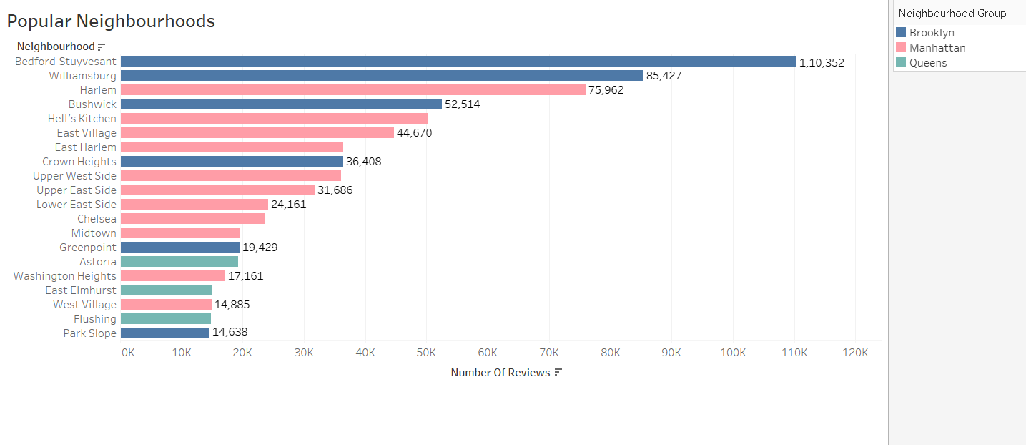
Popular Neighborhoods
The highest number of reviews, totaling 110,352, was recorded in Bedford-Stuyvesant, Brooklyn, making it the most popular neighbourhood. It was closely followed by Williamsburg.
Harlem in Manhattan received the highest number of reviews, with Hell's Kitchen ranking second.
The abundance of customer reviews in these neighbourhoods suggests a higher level of satisfaction among visitors.

Slide 11
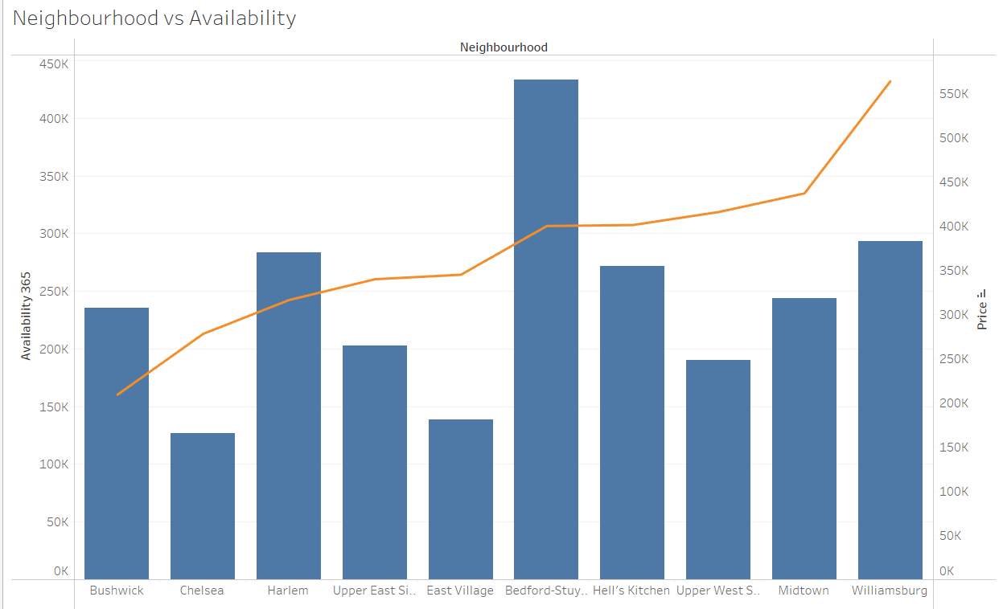
Neighbourhood vs Availability
Bedford exhibits the highest availability and comparatively lower prices, making it an attractive choice for customers.
Harlem follows a similar trend with high availability and relatively affordable prices.
Chelsea, despite its lower availability, has higher prices, making it a more expensive option.
Conversely, William has higher prices but average availability.

